Slide 1

Chapter 14 – part I

Slide 2
OUTLINE
  Mathematical description of oscillations.
  Simple harmonic motion.
  Energy in SHM.

Slide 3
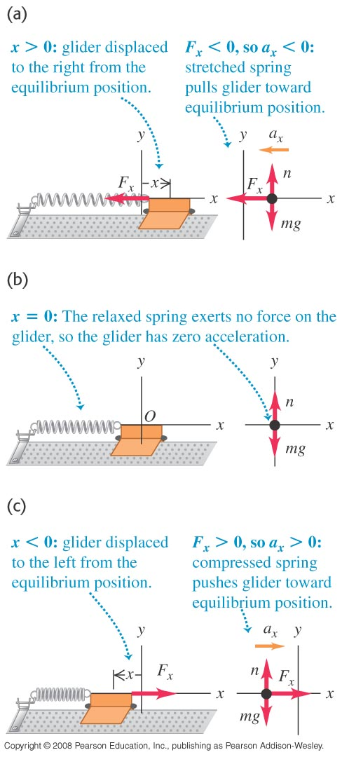
What causes periodic motion?
If a body attached to a spring is displaced from its equilibrium position, the spring exerts a restoring force on it, which tends to restore the object to the equilibrium position. This force causes oscillation of the system, or periodic motion.
Figure at the right illustrates the restoring force F_{x}.

Slide 4
Characteristics of periodic motion
The amplitude, A, is the maximum magnitude of displacement from equilibrium.
The period, T, is the time for one cycle.
The frequency, f, is the number of cycles per unit time.
The angular frequency, ω, is 2π times the frequency: ω = 2πf.
The frequency and period are reciprocals of each other: f = 1/T and T = 1/f.

Slide 5
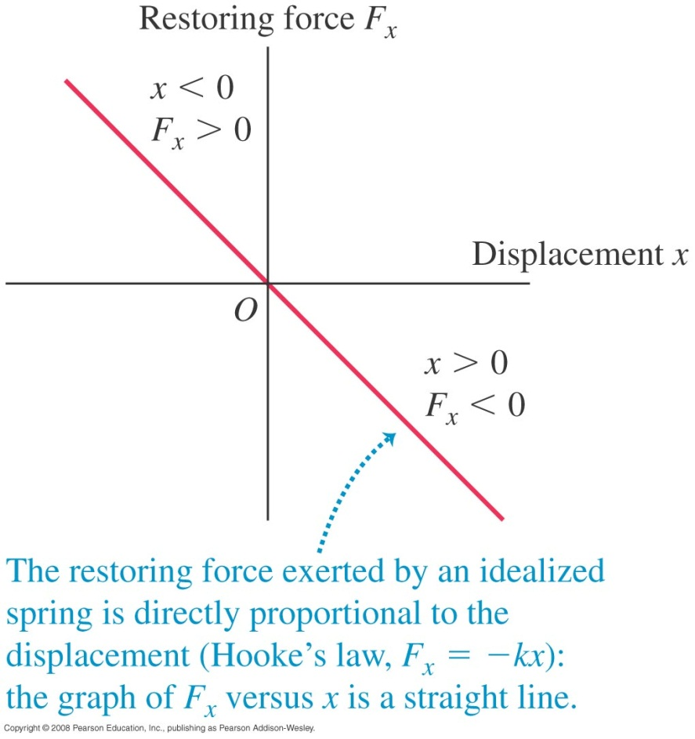
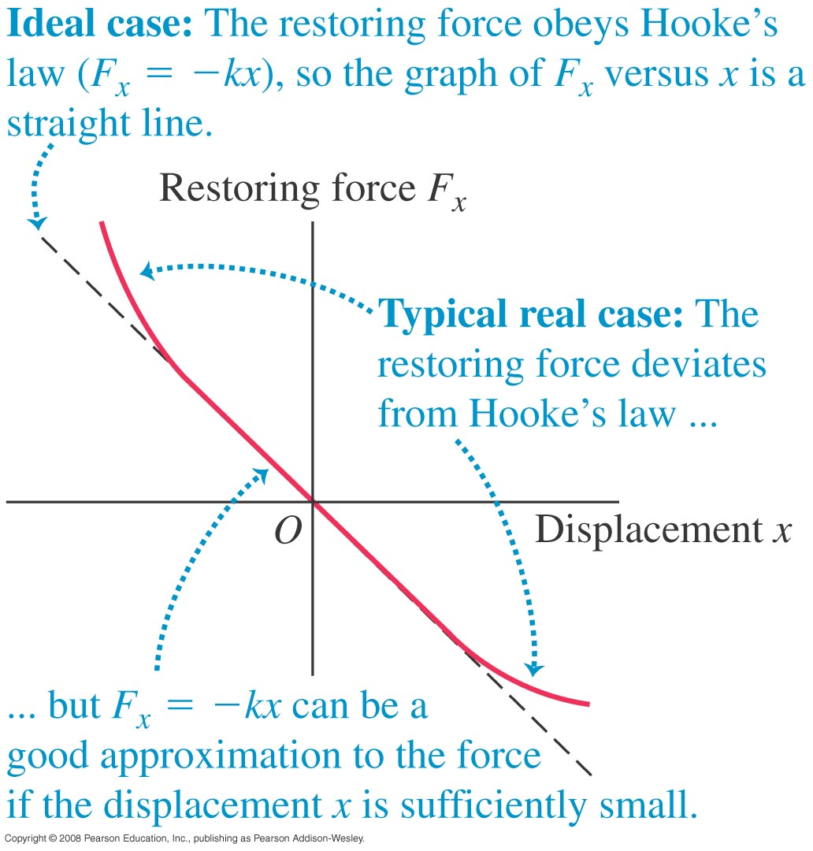
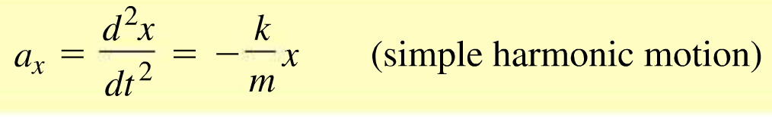
Simple harmonic motion (SHM)
When the restoring force is directly proportional to the displacement from equilibrium, the resulting motion is called simple harmonic motion (SHM).
An ideal spring obeys Hooke’s law, so the restoring force is F_{x} = –kx, which results in simple harmonic motion.

Slide 6
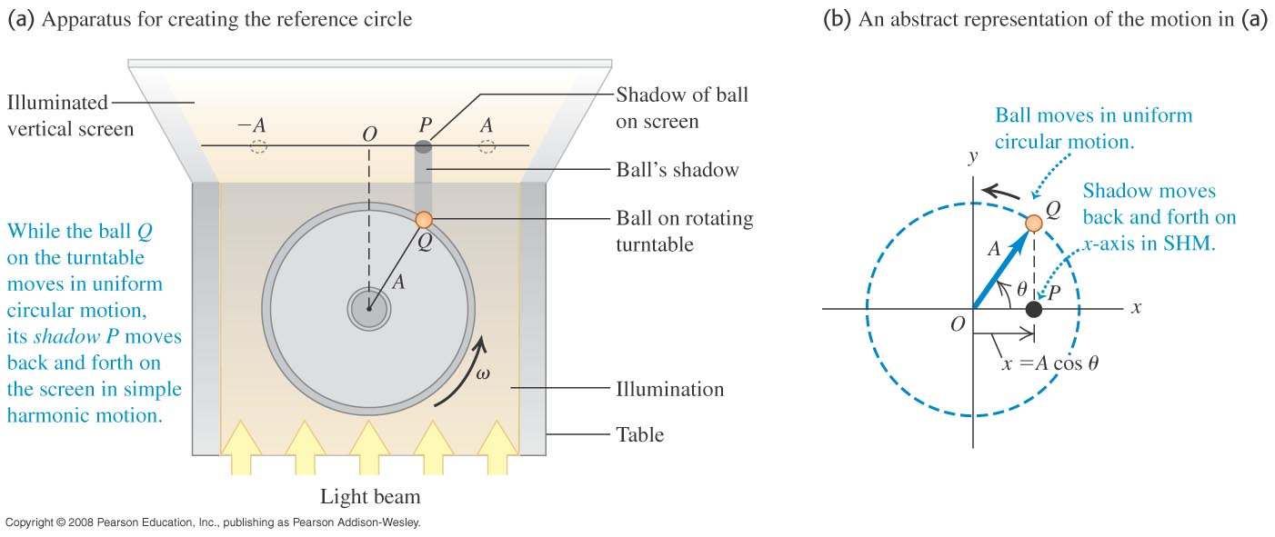
Simple harmonic motion viewed as a projection
Simple harmonic motion is the projection of uniform circular motion onto a diameter, as illustrated in Figure below.

Slide 7
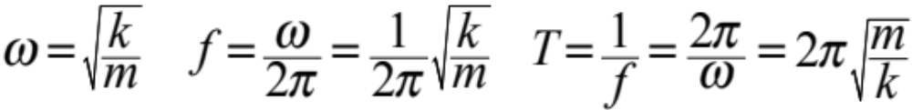
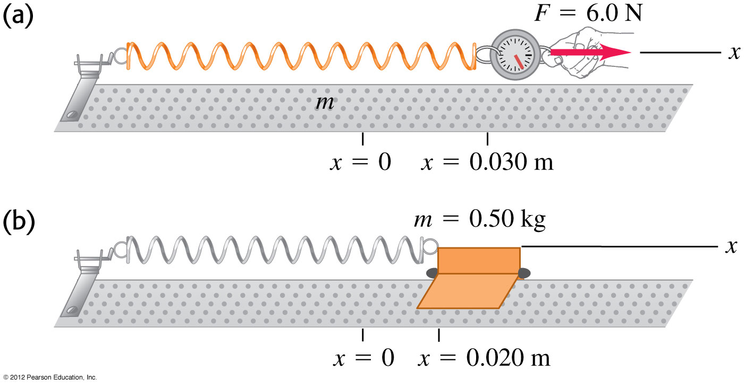
Characteristics of SHM
For a body vibrating by an ideal spring:

Slide 8
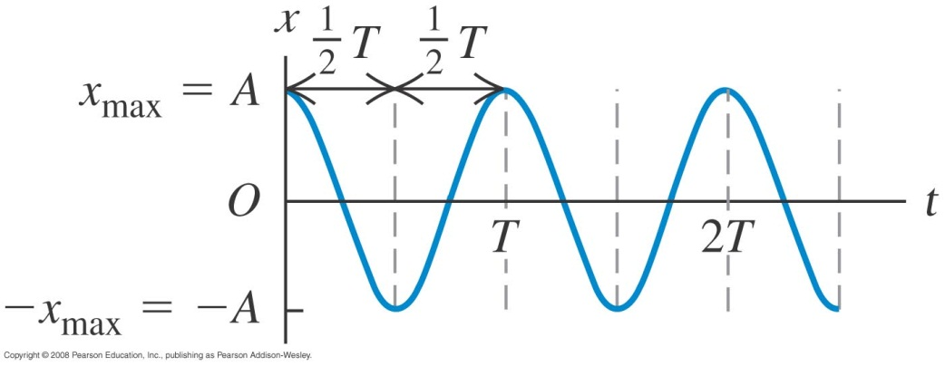
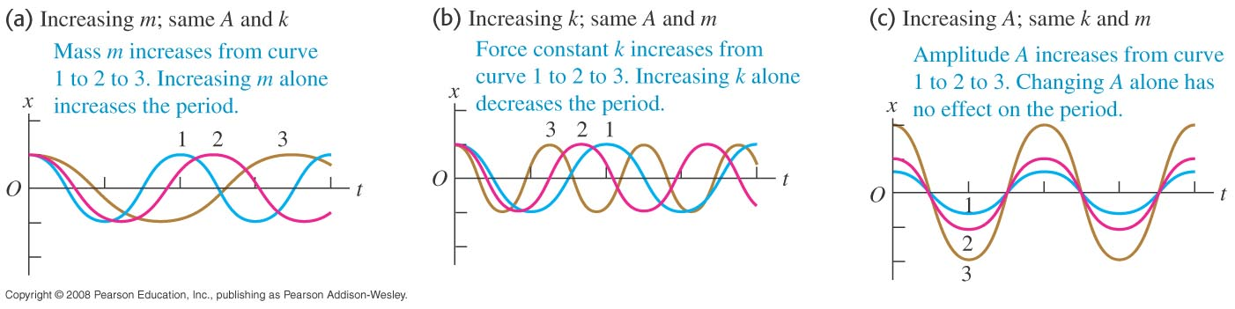
Displacement as a function of time in SHM
The displacement as a function of time for SHM with phase angle ϕ is x = Acos(ωt + ϕ). (See Figure at the right.)
Changing m, A, or k changes the graph of x versus t, as shown below.

Slide 9
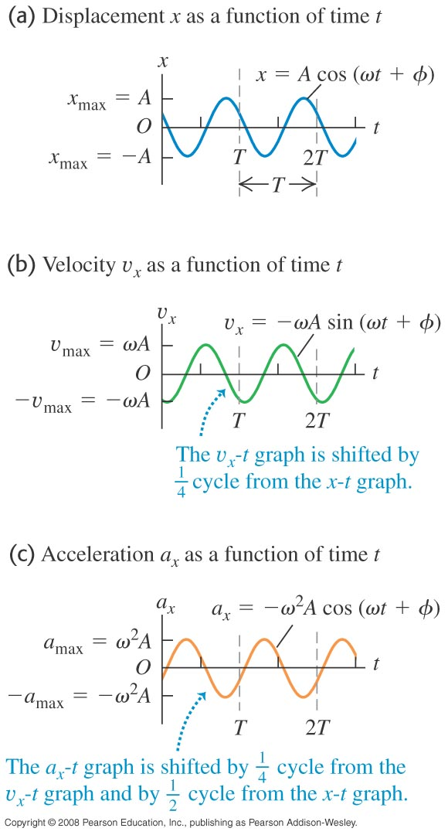
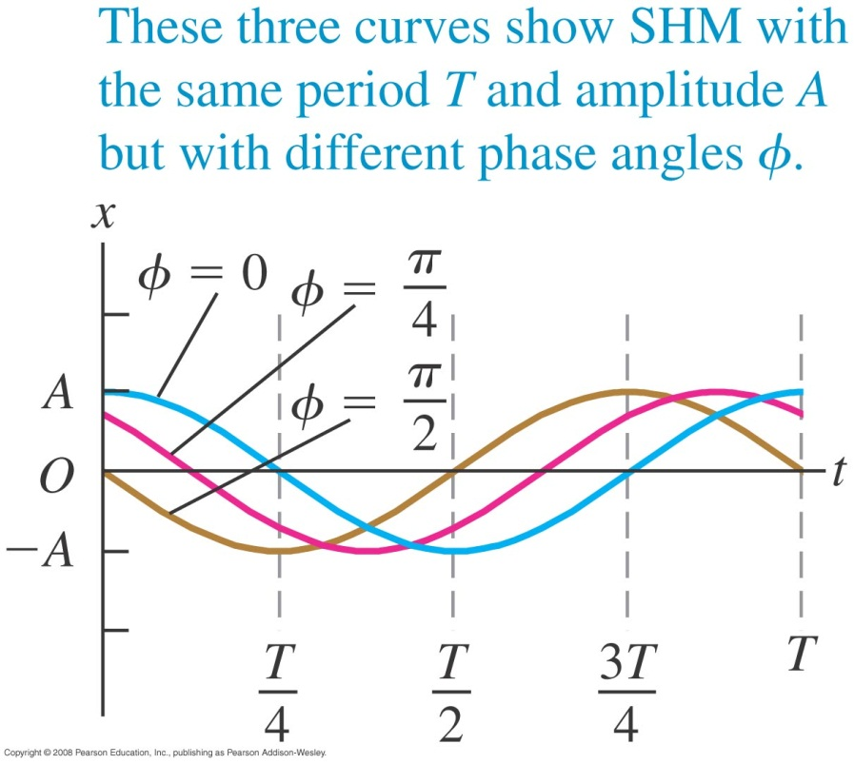
Graphs of displacement, velocity, and acceleration
The graph below shows the effect of different phase angles.
The graphs below show x, v_{x}, and a_{x} for ϕ = π/3.

Slide 10
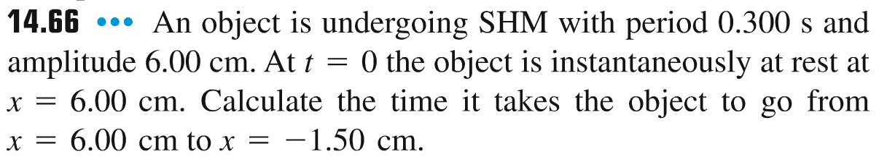
Problem #1

Slide 11
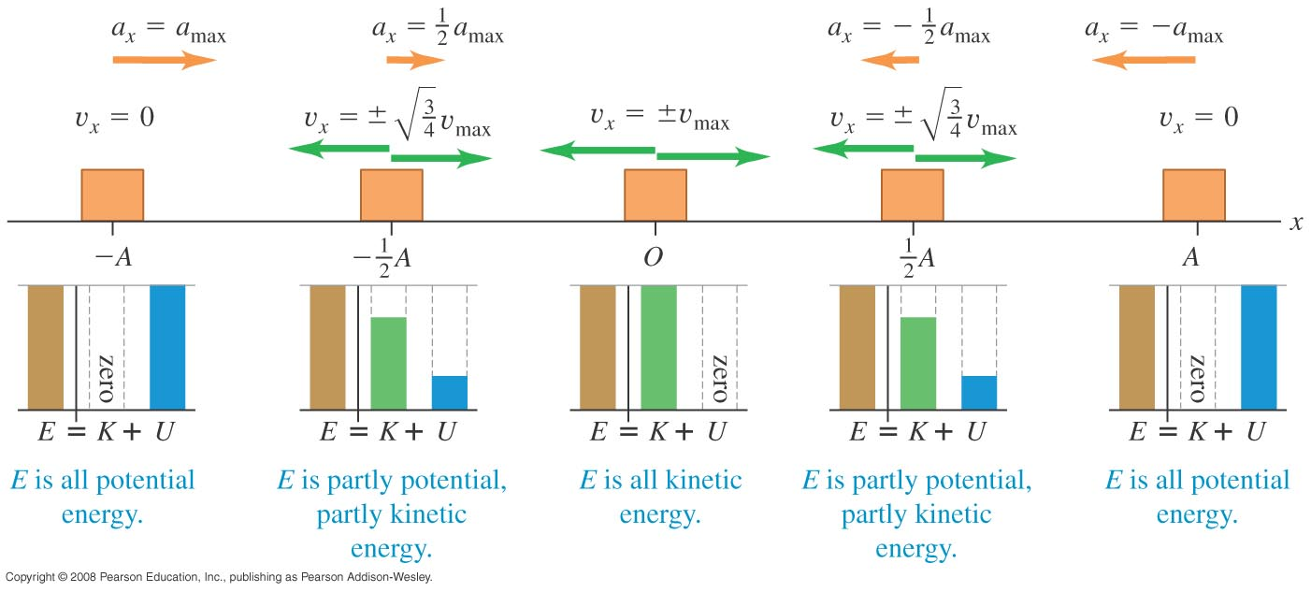
Energy in SHM
The total mechanical energy E = K + U is conserved in SHM:
E = 1/2 mv_{x}² + 1/2 kx² = 1/2 kA² = constant

Slide 12
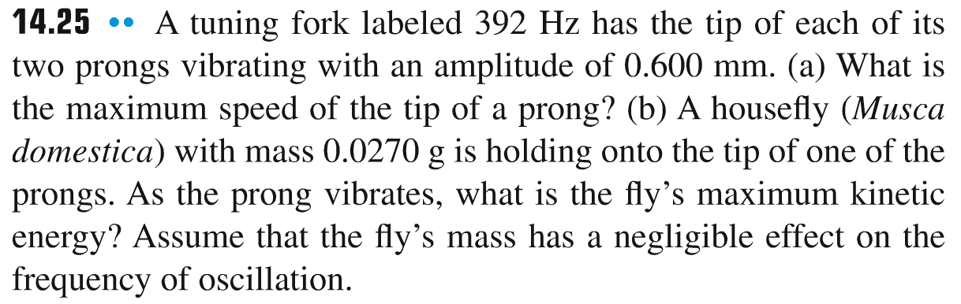
Problem #2

Slide 13
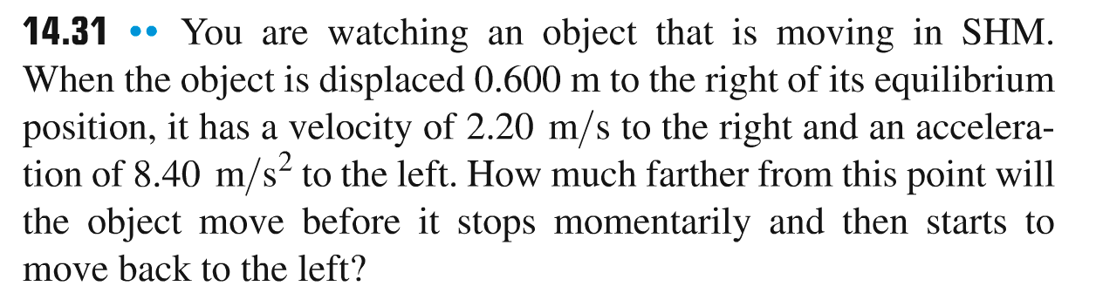
Problem #3

Slide 14
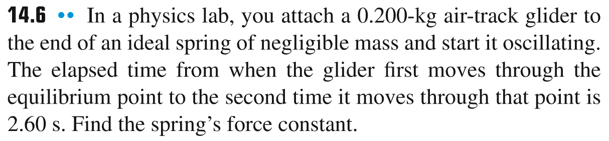
Problem #4

Slide 15
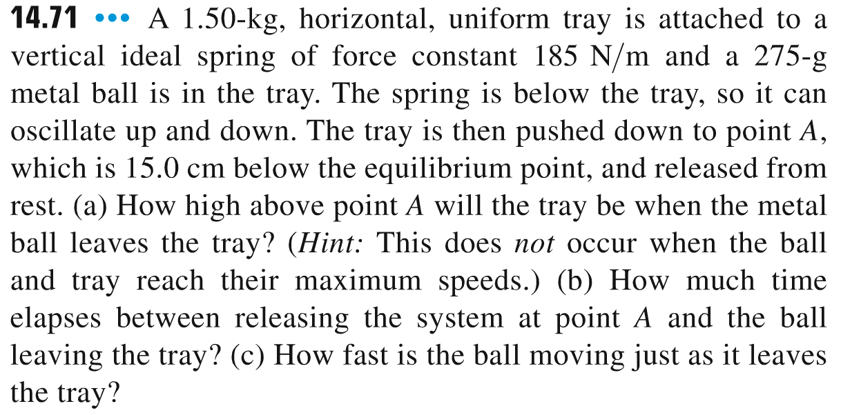
Problem #5

